Slide 1
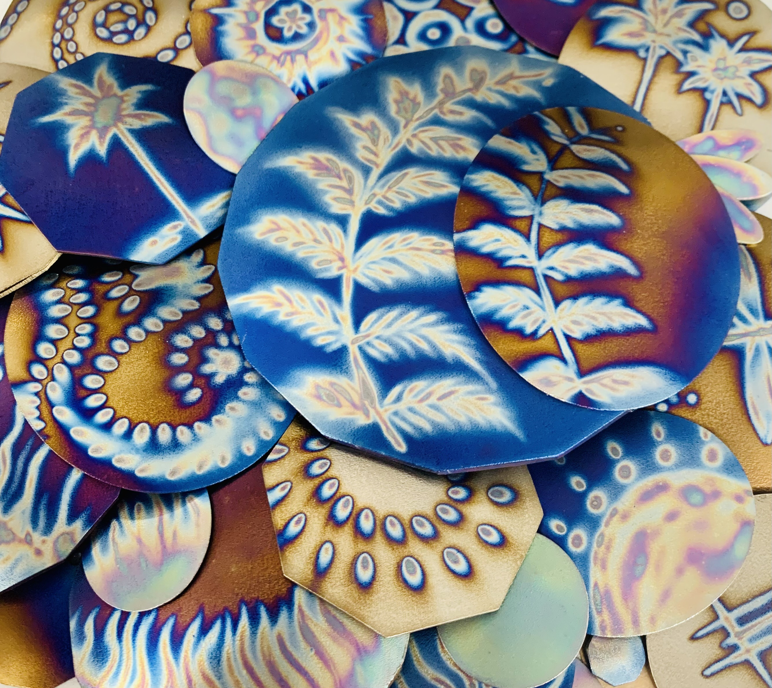
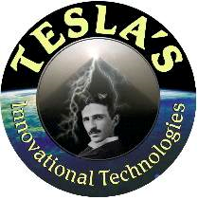
‘to assist
the planet’s return
to harmony and balance
through ethical
Technologies’

Slide 2
Disclaimer
The information in this presentation does not take the place of professional or medical advice.
Do not use our information to diagnose, treat, cure or prevent any disease for therapeutic purposes, or as a substitute for the advice of a health professional.
We do not accept any liability for any injury, loss or damage caused by use of the information provided today.
The information may include the views or recommendations of third parties and does not necessarily reflect the views of Tesla's Innovational Technologies.

Slide 3
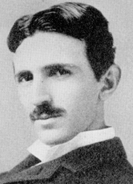
Nikola Tesla
The Man Who Invented the 20th Century
Nicola Tesla was the owner
of 1600 patents.
He received 27 different honorary degrees from universities all over the world ( 1870 to 1925 )

Slide 4
Nikola Tesla
His inventions included the hydroelectric generator, microwave, x-ray,
radar, radio, remote control, fluorescent light, broadcast power, rotary
engine and the tesla coil.

Slide 5
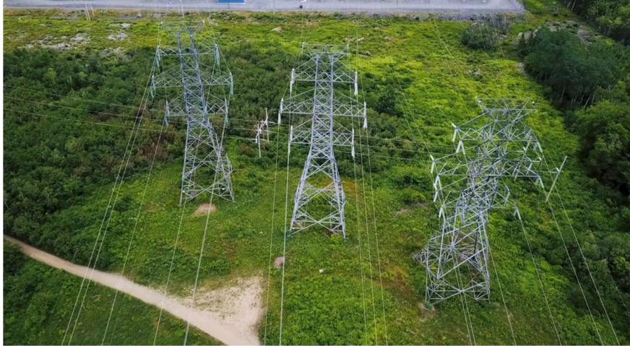
Nikola Tesla
Alternating current – electricity as we know it today

Slide 6
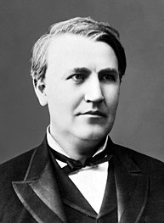

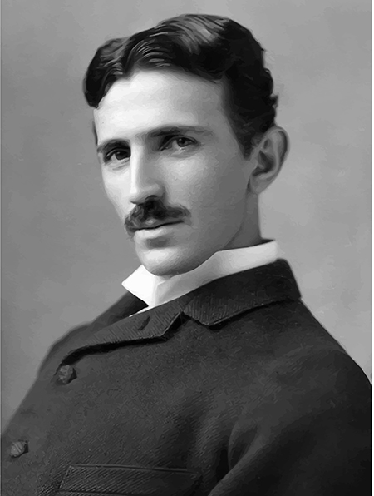
Nikola Tesla
The War of the Currents
Thomas Edison Nikola Tesla

Slide 7
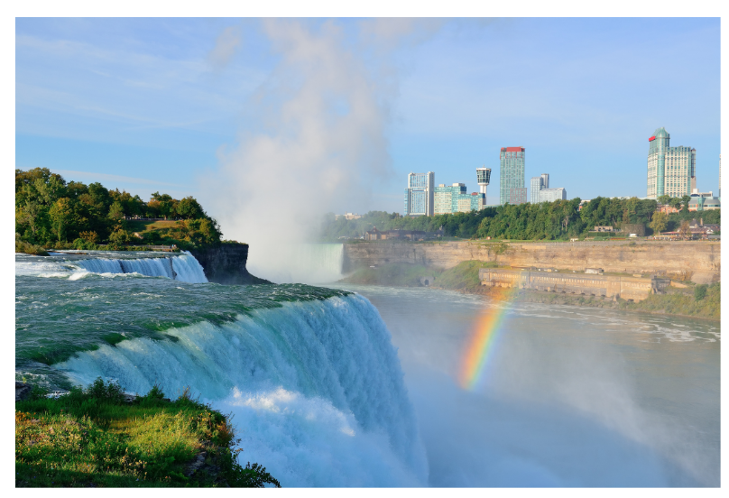
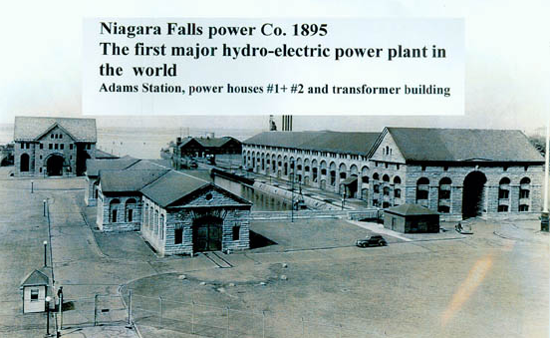
Nikola Tesla
Niagra Power Station

Slide 8
Nikola Tesla
Tesla was quoted as saying to a group of English scientists only months after the opening of the Niagara Power Station (1895),
“The electricity I have invented will prove to be one of the most dangerous things on Earth to man and I’m looking at an alternative.”

Slide 9
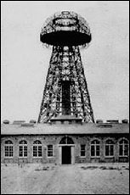
Wardenclyffe Tower.
Nikola Tesla had the tower built in 1901 to transmit free energy.

Slide 10
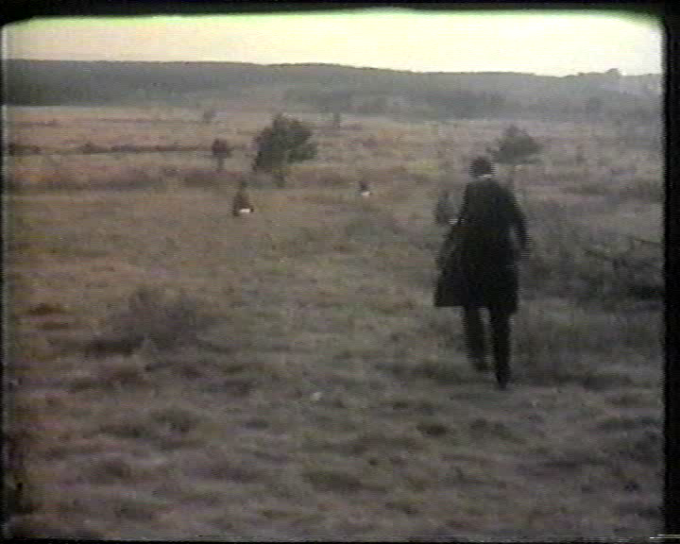

Slide 11
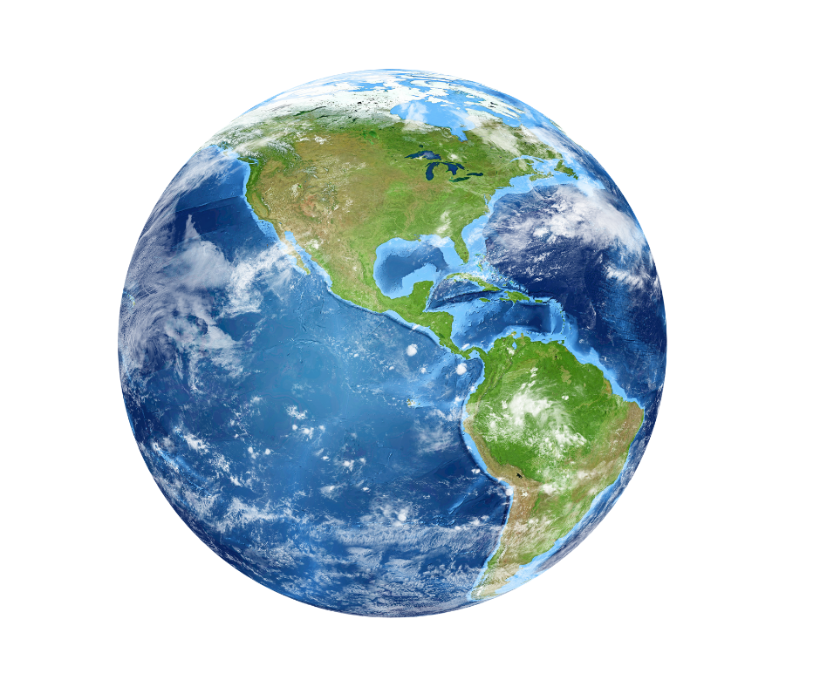


Slide 12
Geopathic stress – above and below ground
Geopathy is the scientific theory that links the earth’s inherent radiation with the health of humans, plants and animals.
geo=earth pathic=disease
We now have another form of geopathic stress, specifically caused by the invention of electricity.

Slide 13
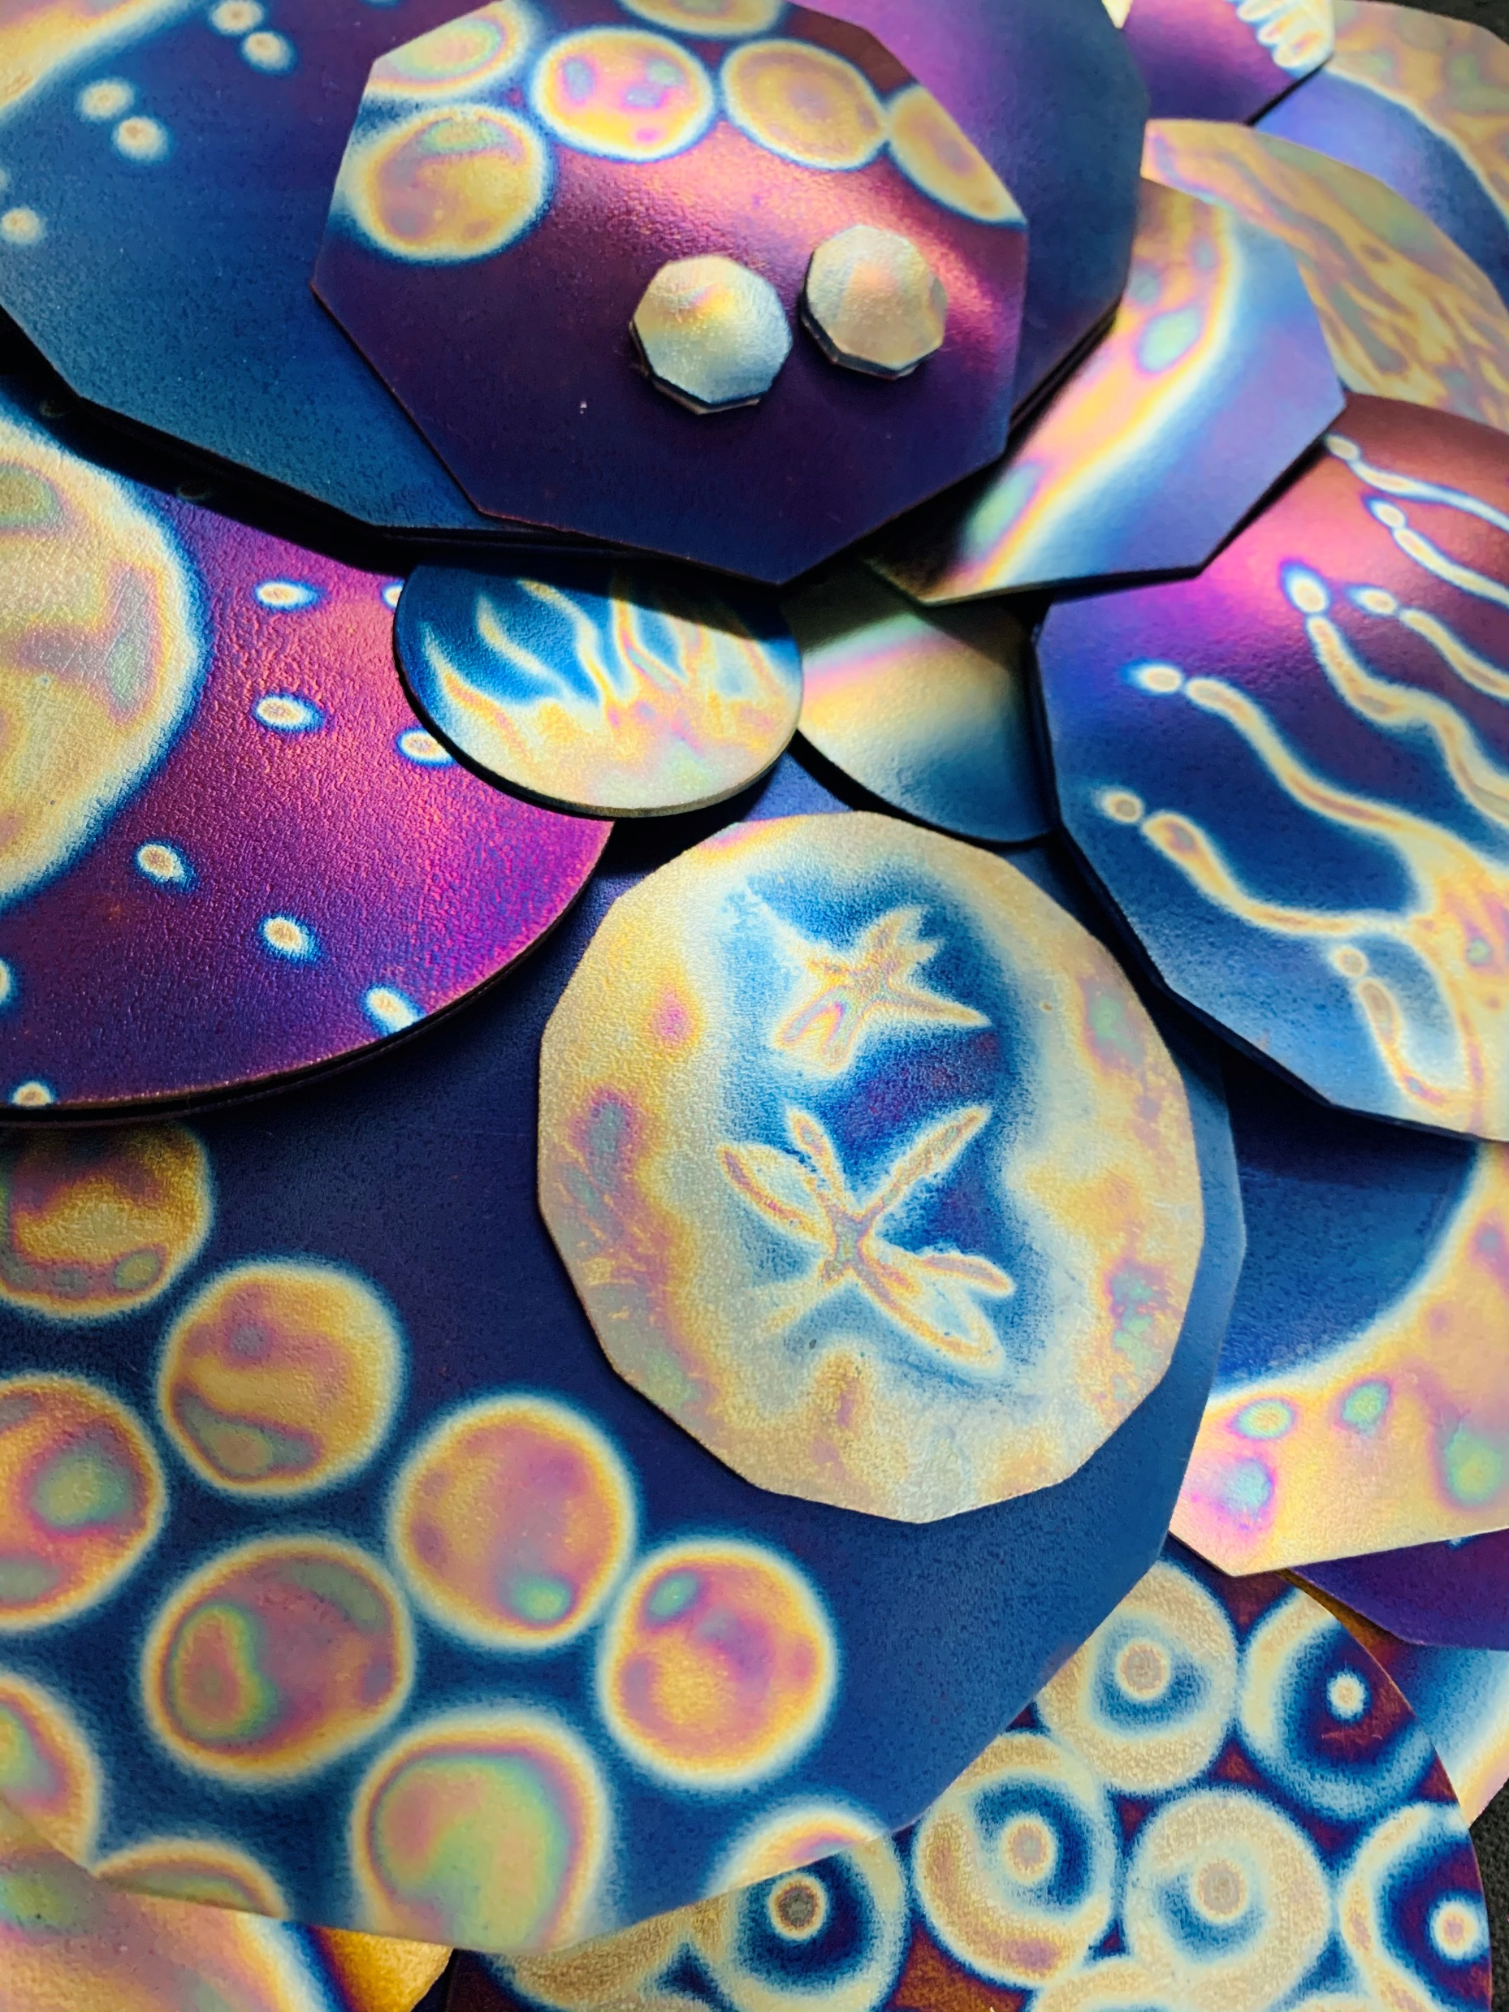
Underground Geopathic Stress

Slide 14
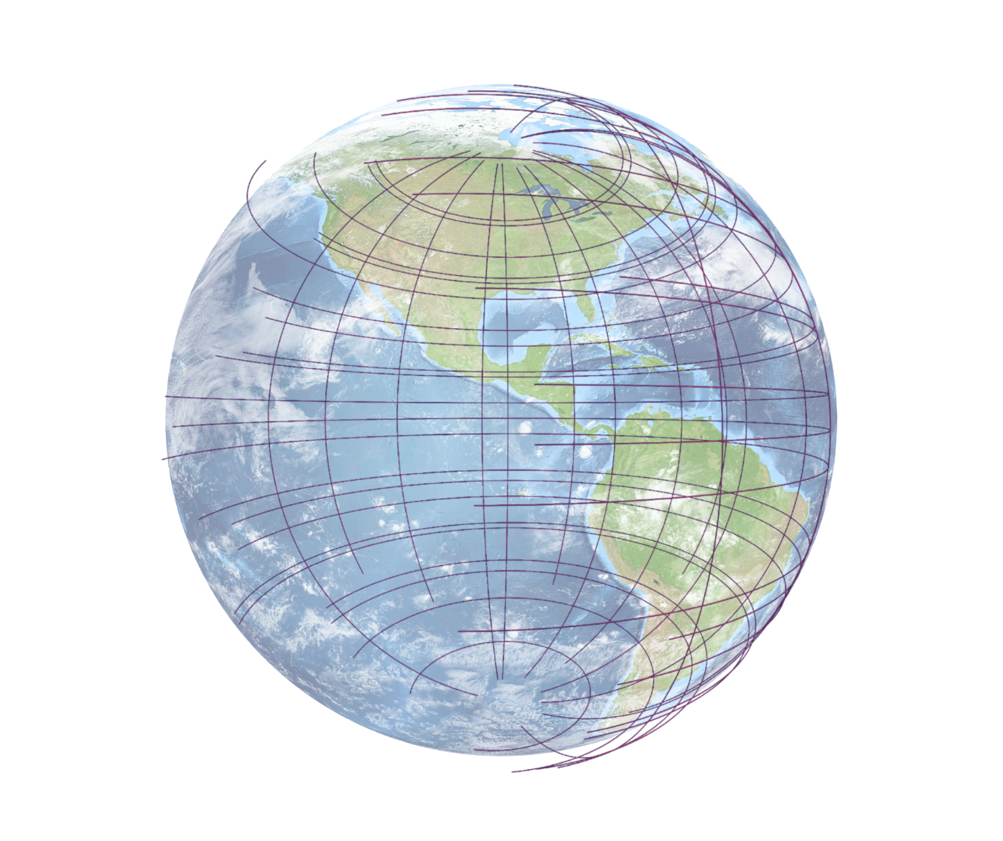
Underground Geopathic Stress
ley lines

Slide 15
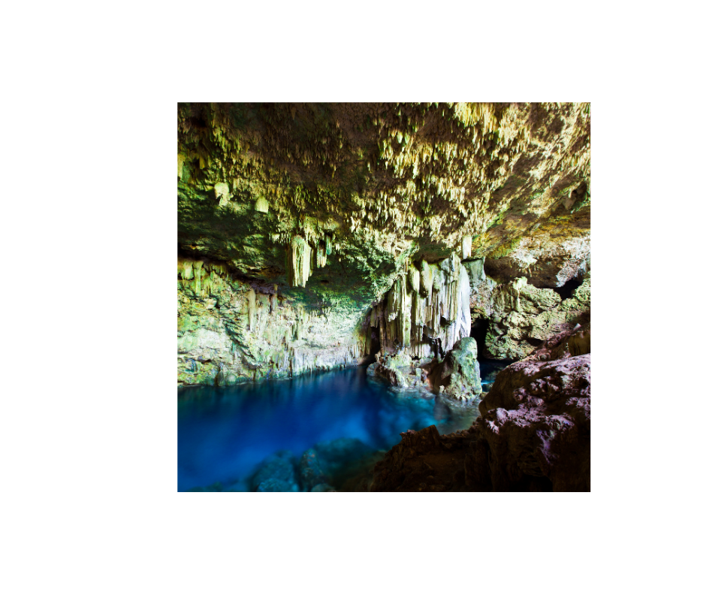
Underground Geopathic Stress
ley lines artesian water

Slide 16

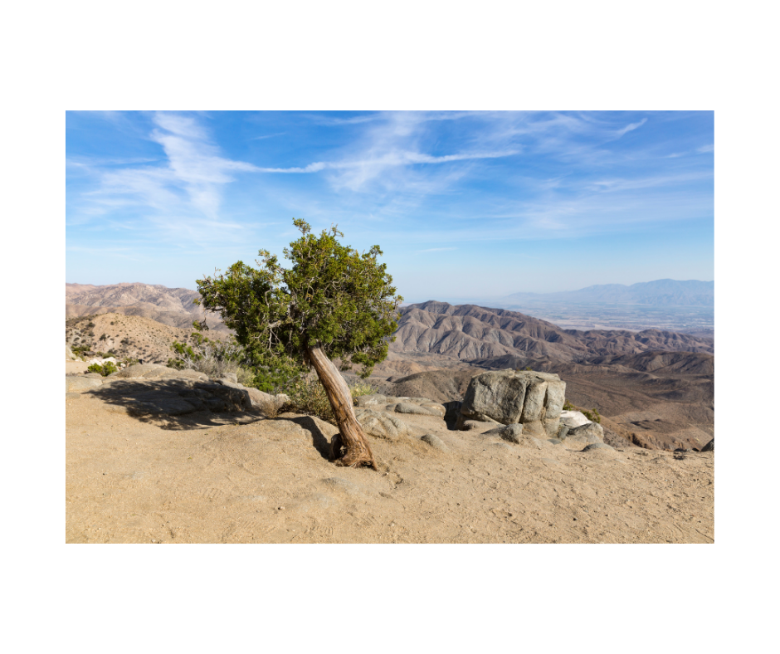
Underground Geopathic Stress
ley lines artesian water dry faults

Slide 17
Underground Geopathic Stress
artesian water

Slide 18
Nikola Tesla
“The electricity I have invented will prove to be one of the most dangerous things on Earth to man...”

Slide 19
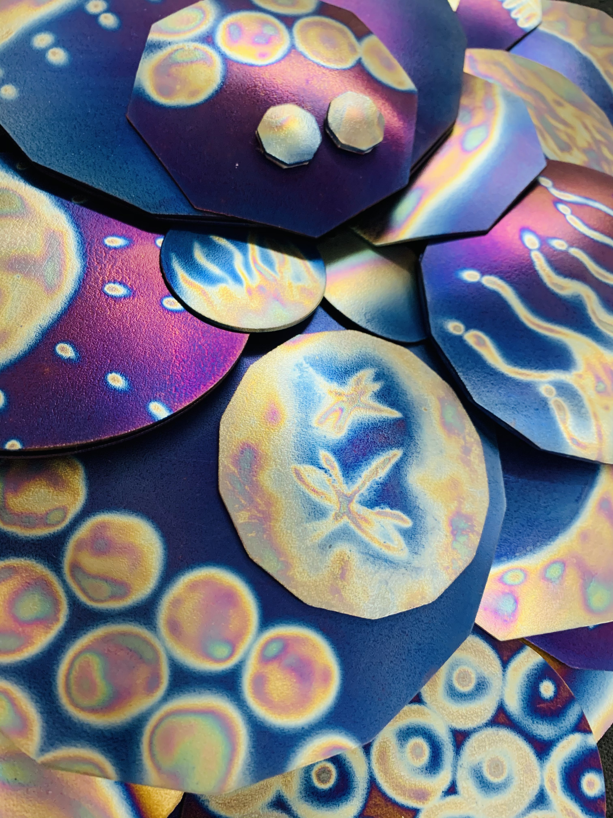
Above Ground Geopathic Stress
EMF – electromagnetic fields
EMR – electromagnetic radiation

Slide 20
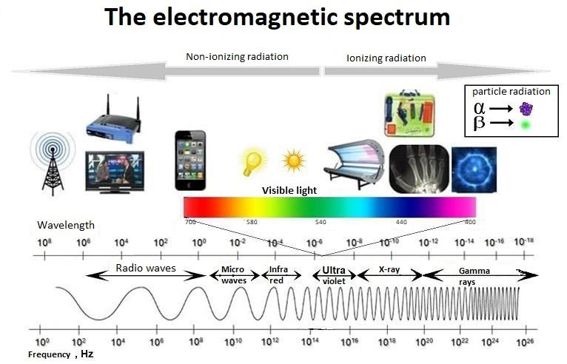

Slide 21
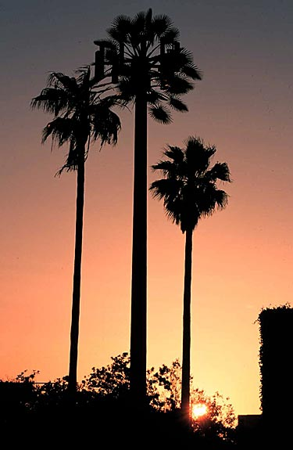
Above ground Geopathic Stress
phone towers

Slide 22
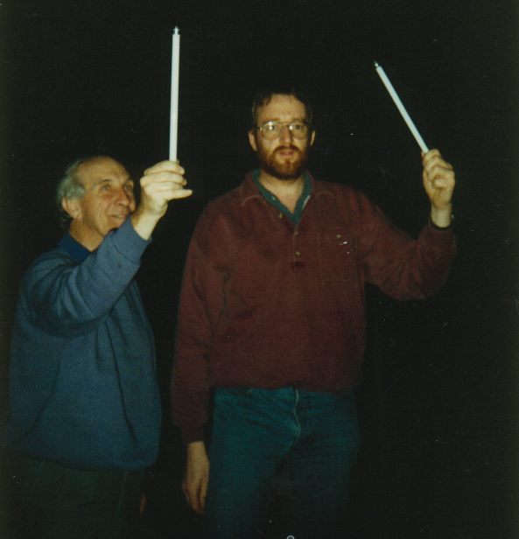
Above ground Geopathic Stress
phone towers power lines

Slide 23
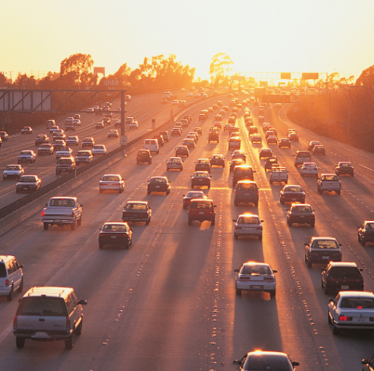
Above ground Geopathic Stress
phone towers power lines transport

Slide 24

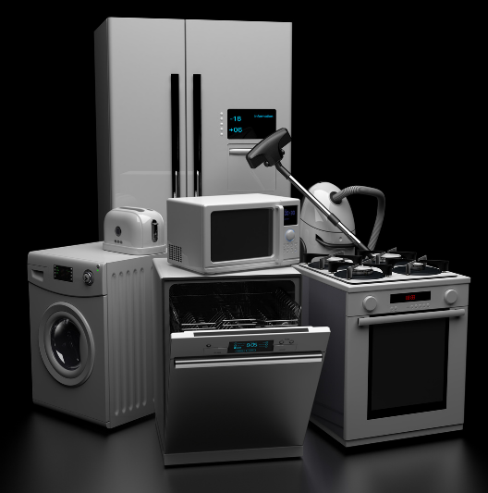
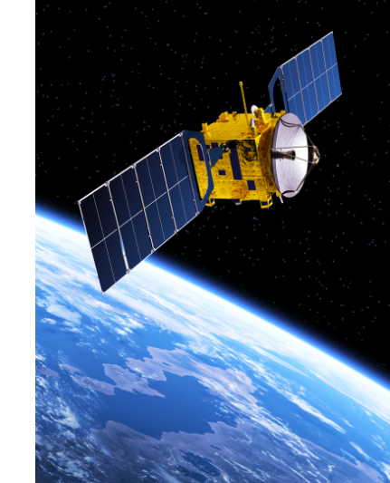
Above Ground Geopathic Stress
our homes, our offices, our devices

Slide 25

Geopathic Stress

Slide 26

Geopathic Stress
underground running water

Slide 27

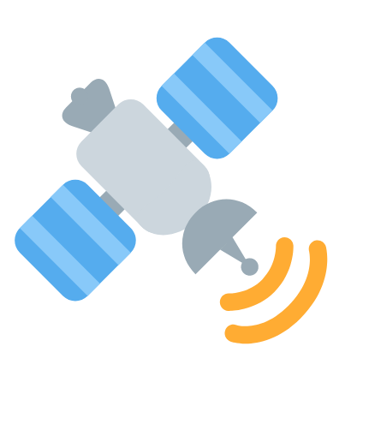
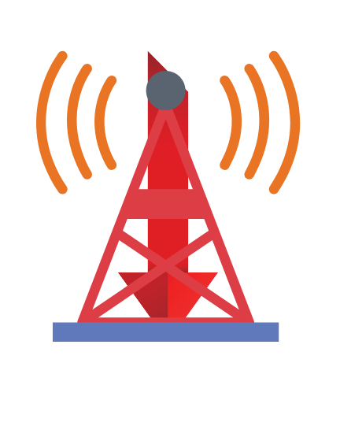
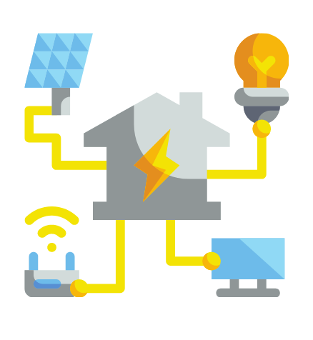
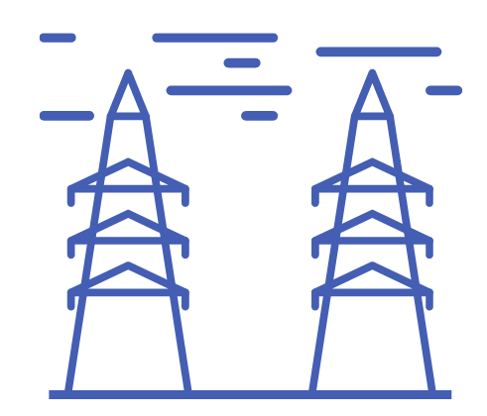
Geopathic Stress
underground running water

Slide 28


Geopathic Stress
underground running water

Slide 29

Geopathic Stress
underground running water

Slide 30

Geopathic Stress
underground running water

Slide 31
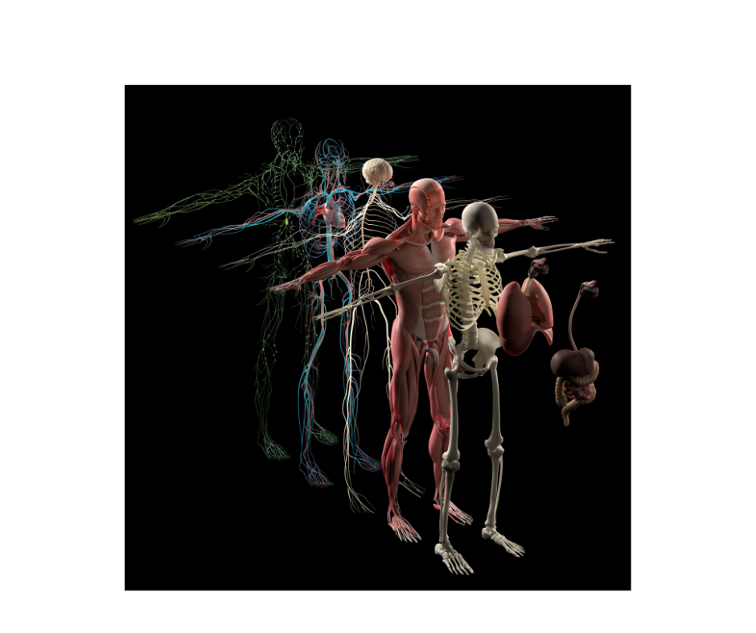
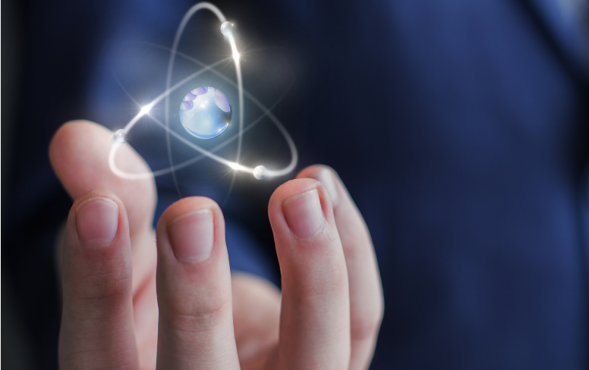
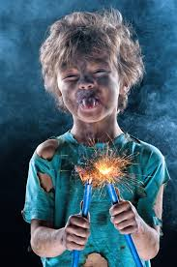
Why Are Humans Affected?
Because we conduct electricity!

Slide 32
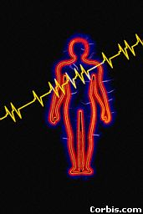
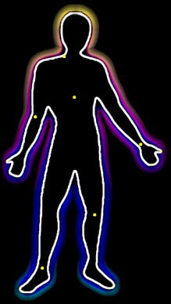
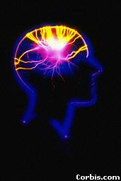
How Are Humans Affected?
Man-made EMF and EMR produce
chaotic patterns at the subatomic level

Slide 33
How Are Humans Affected?
Geopathic Stress does not CAUSE any illness, but lowers the immune system and your ability to fight off viruses and bacteria.
It is a weak, but continuous, stress to the DNA.
Over a period of years it seriously disrupts metabolism on a molecular scale.

Slide 34
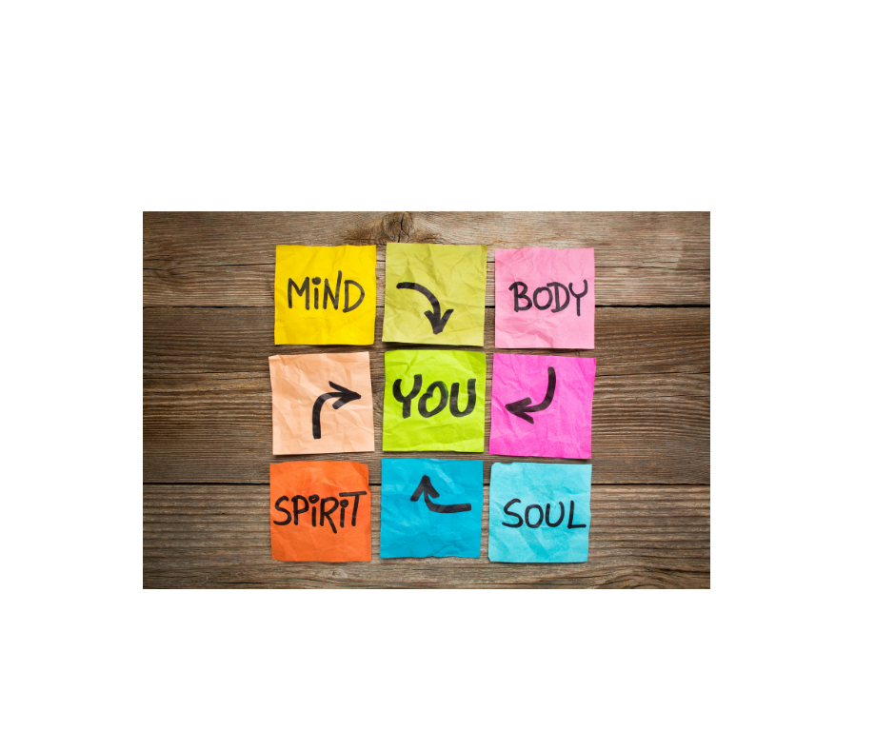
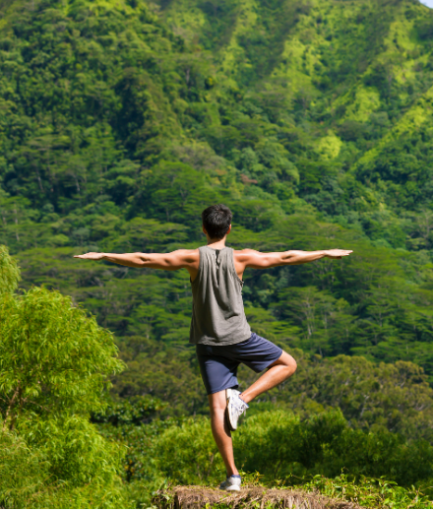
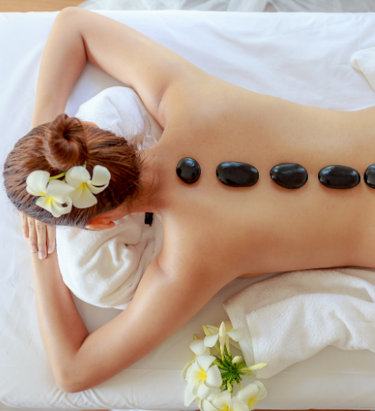

Slide 35
Wardenclyffe Tower, which Nikola Tesla built to transmit free energy in 1901.

Slide 36
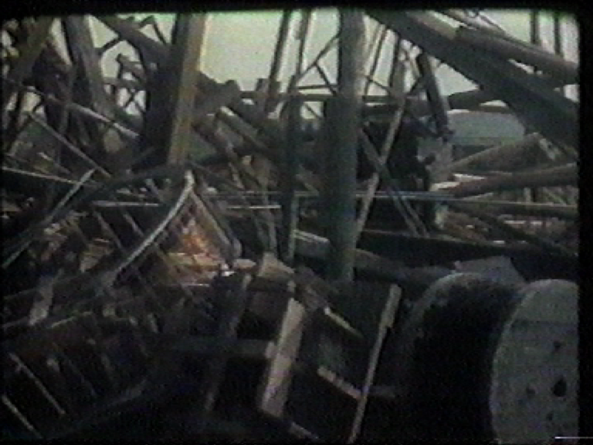
The military demolished the tower during World War II
‘just in case’ it was transmitting to the enemy.

Slide 37
The Nikola Tesla Link
Tesla

Slide 38
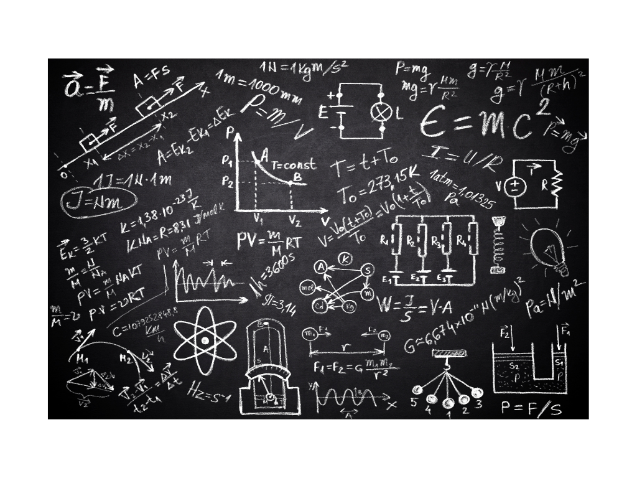
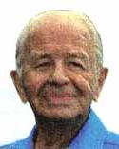

The Nikola Tesla Link
Tesla Ralph Bergstresser

Slide 39
The Nikola Tesla Link
Tesla Ralph Bergstresser Tesla’s CEO

Slide 40


Slide 41
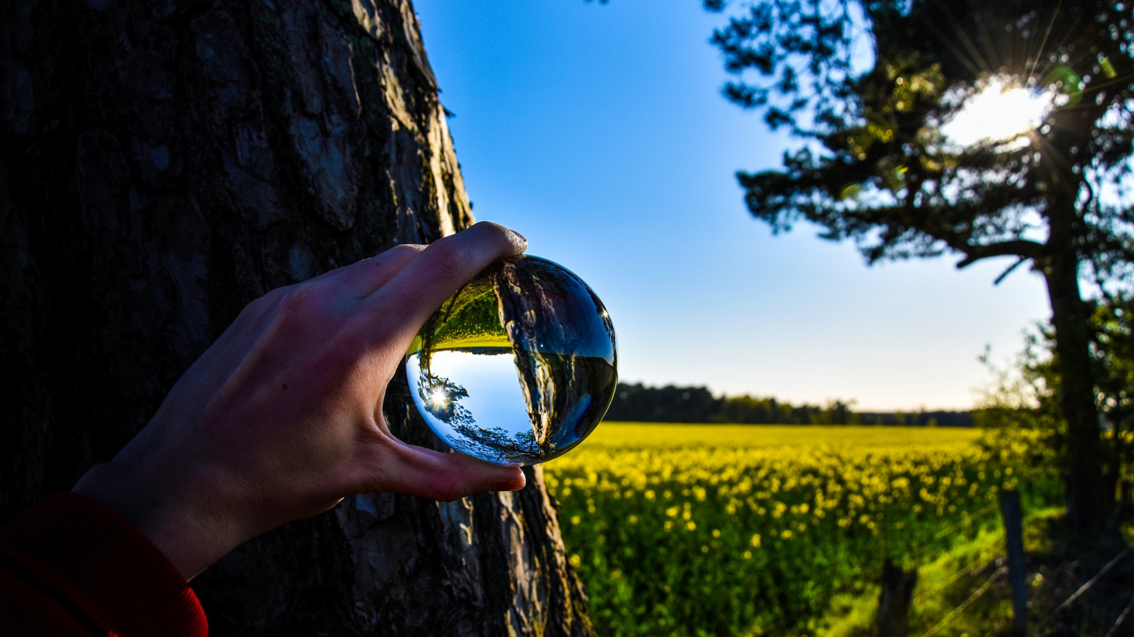
Personal Range
Experience the Tesla’s Bubble.
Take your environment
back to nature.

Slide 42
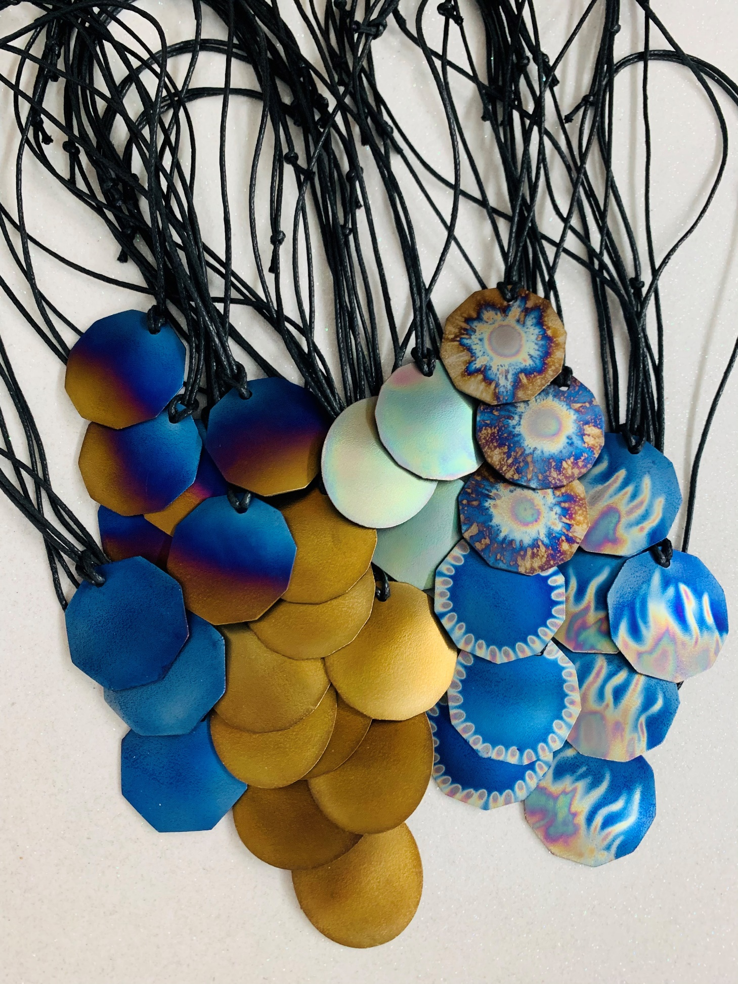
The Pendants

Slide 43
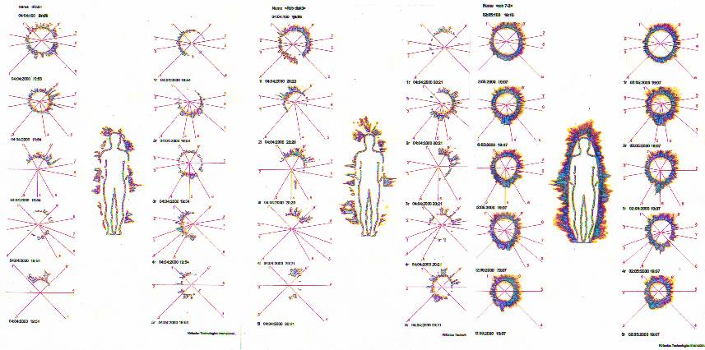
After wearing a pendant for 20 minutes.
After wearing a pendant for 28 days.
No pendant.

Slide 44
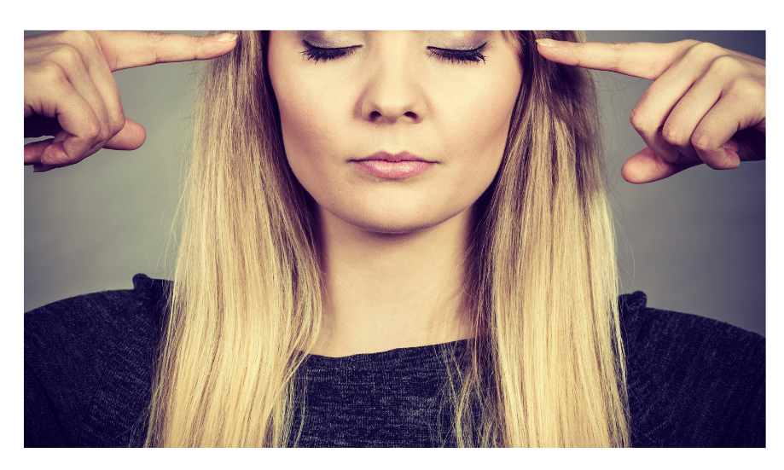

How to Choose Your Pendant

Slide 45
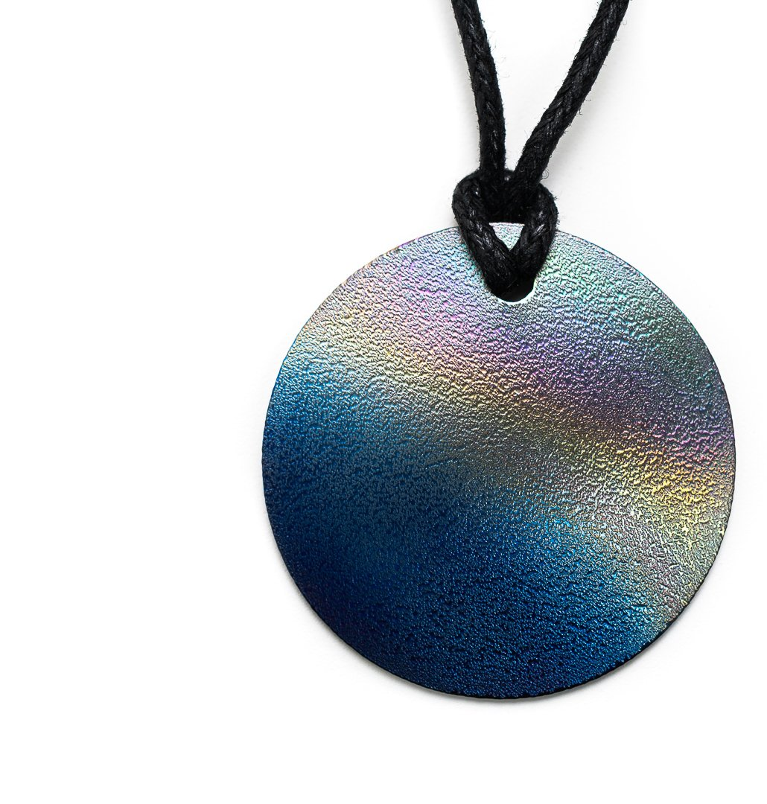
The Adult Pendant

Slide 46
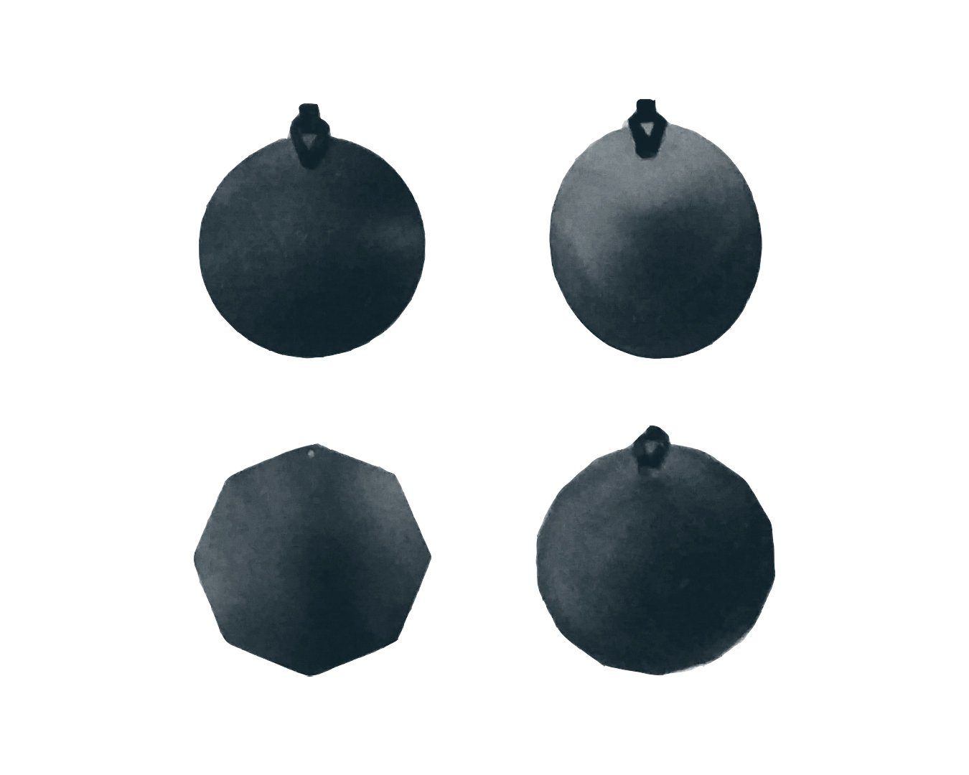
Which shape resonates with you?
round
oval
8-sided
14-sided

Slide 47
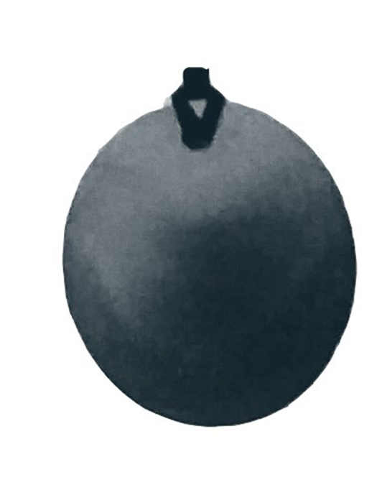
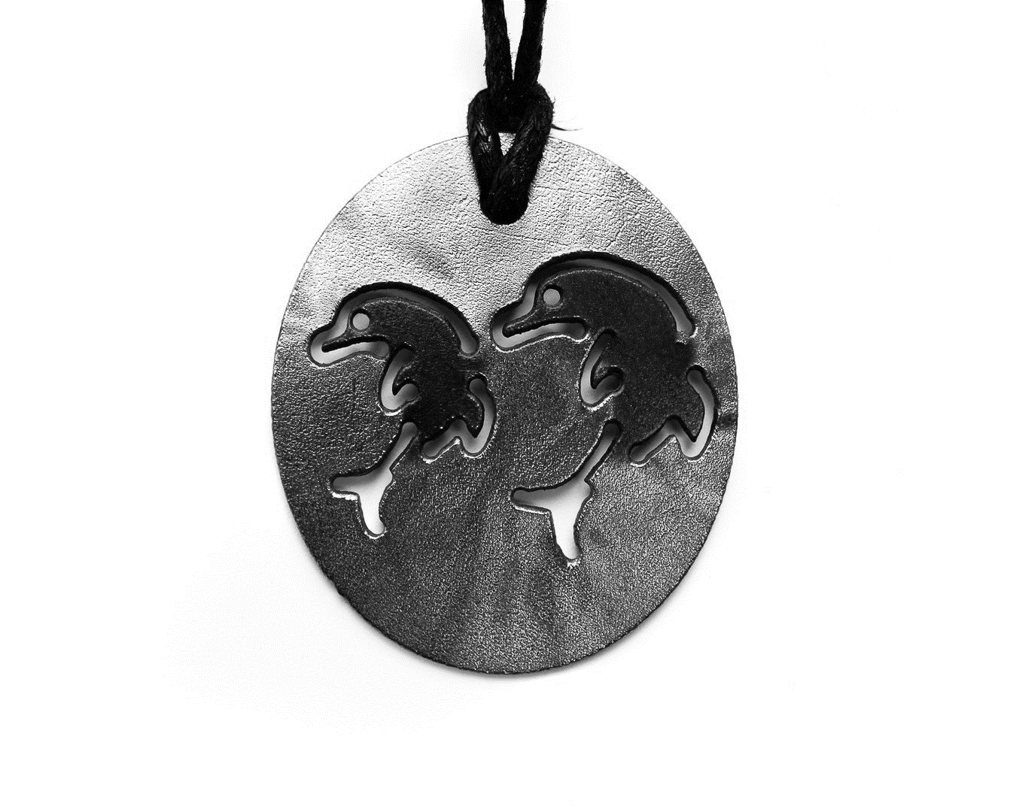
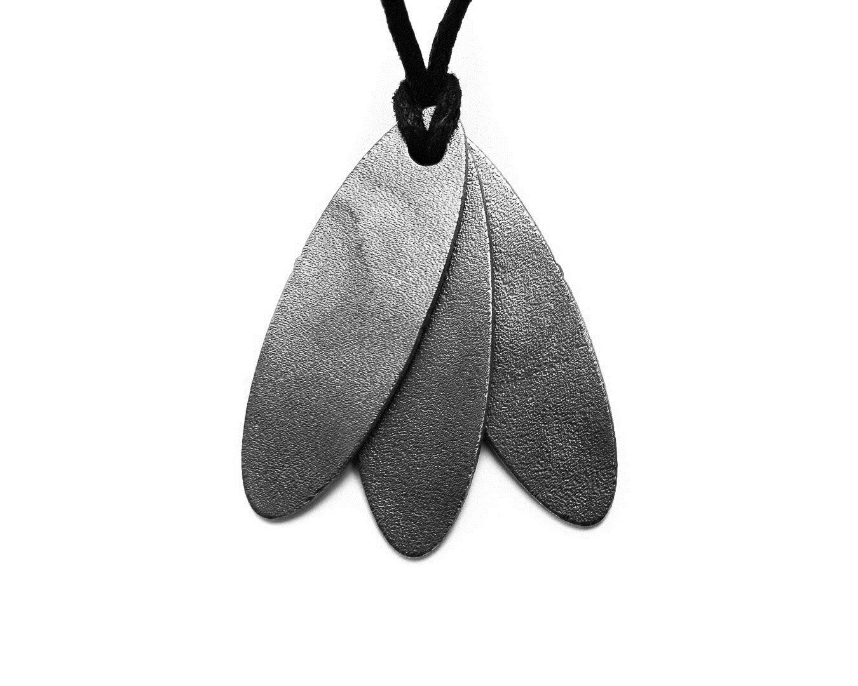
Which shape resonates with you?
Oval?
Choose between double dolphin, oval and surfboard.

Slide 48
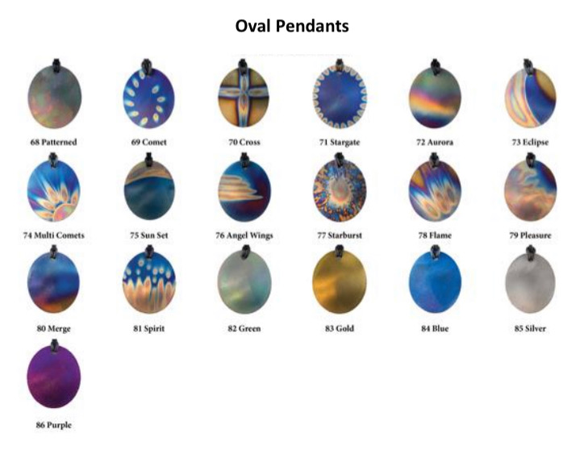
Choose your Design

Slide 49
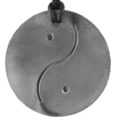
Which shape resonates with you?
Round?
Choose between round and round yin yang.

Slide 50
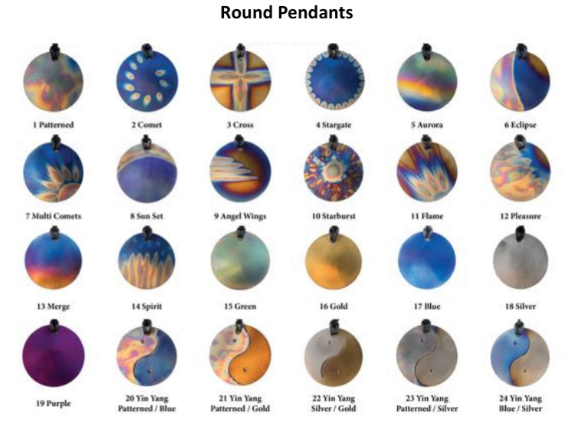
Choose your Design

Slide 51


Which shape resonates with you?
14-sided?
Choose between 14-sided and
14-sided yin yang.

Slide 52

Which shape resonates with you?
8-sided?
You are ready to choose your colours!

Slide 53

Choose your Design

Slide 54

The Ten Sided Pendant

Slide 55

Choose your Design

Slide 56


The Teen Pendant

Slide 57

The Child’s Pendant

Slide 58


The Furry Friends’ Pendant

Slide 59

The Phone Tag

Slide 60


MRI Scan
Radiation penetration in the head of an adult
Radiation penetration
in the head
of a teenager
Radiation penetration
in the head of a child

Slide 61

The energy field of a lady who had used her mobile phone 2 hours earlier.
The same lady’s energy field while using her phone for 10 minutes with NO Phone Tag.
The same lady while using her phone for 10 minutes with a Phone Tag fitted.

Slide 62



no phone phone
phone with
phone tag

Slide 63

The Pocket Plate
our pocket rocket

Slide 64


The 5G
Oyster Plates
building the foundation of your peaceful bubble

Slide 65

The Electron
Stabiliser
from chaotic to coherent

Slide 66


The Water Kit
Negatively ionise your water
(that’s a positive thing)

Slide 67


The Car Plate and the Hybrid Car Kit
goodbye road rage ;)

Slide 68

Small Octagonal
Plate

Slide 69

Laptop/Tablet Tags

Slide 70


The House Kit
‘What did you do? Did you repaint?’

Slide 71

The Town Kit

Slide 72

The Bare
Essentials Kit

